Slide 1
kodeBlogger
by
Nikki Aaron, Tristan Benedict-Hall, Aaron Brinkley, David Friend, & Kevin Surmacewicz

Slide 2
concept
API for writing and saving code tutorials displayed in Rich Text with syntax highlighted code blocks
Dynamic Parsing
Take user input => Rich Text + < code /> and display side by side
Users can “step” through tutorial

Slide 3
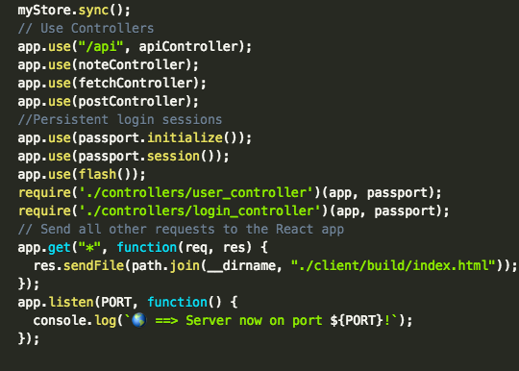
motivation
Resource for all of us!
Different format for displaying blog posts
Code side by side instead of below

Slide 4
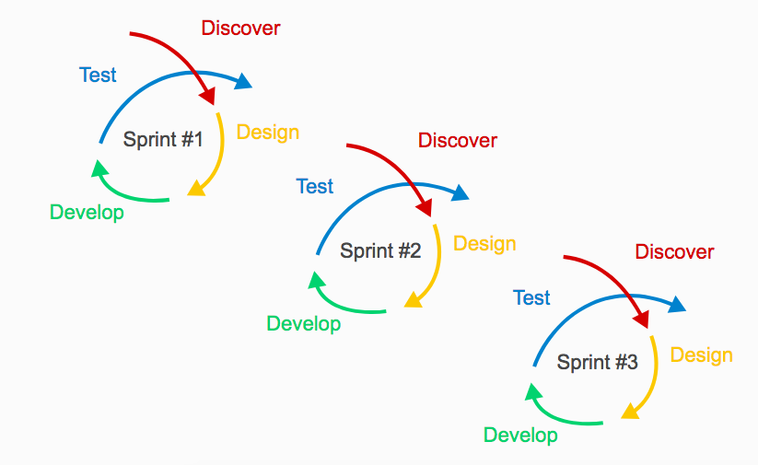
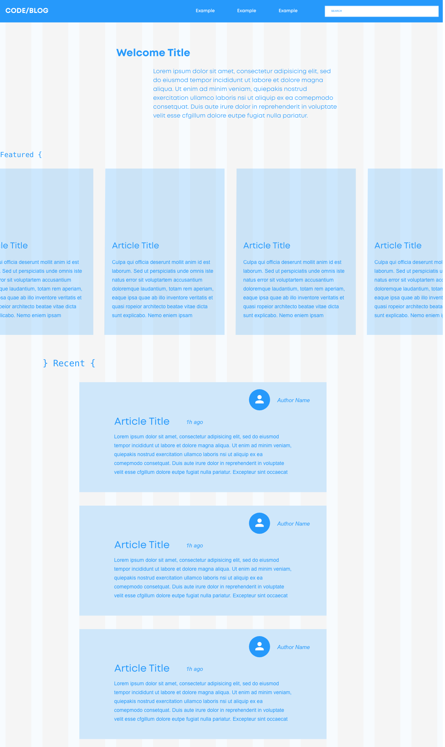
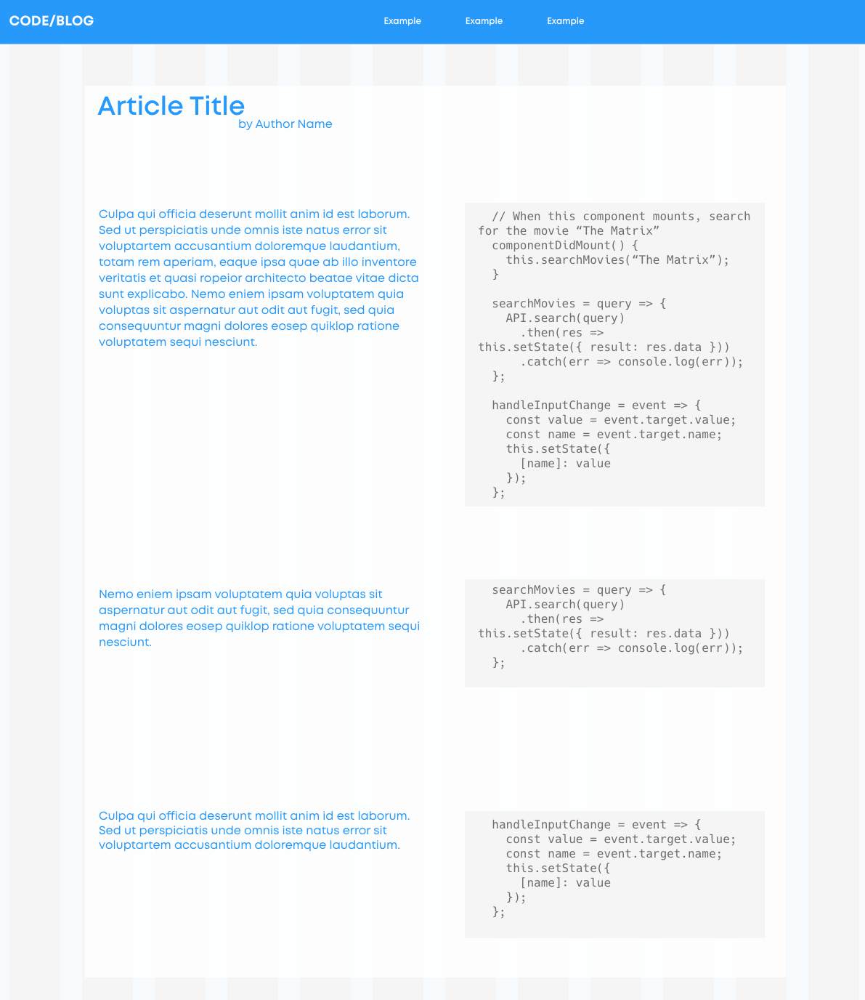
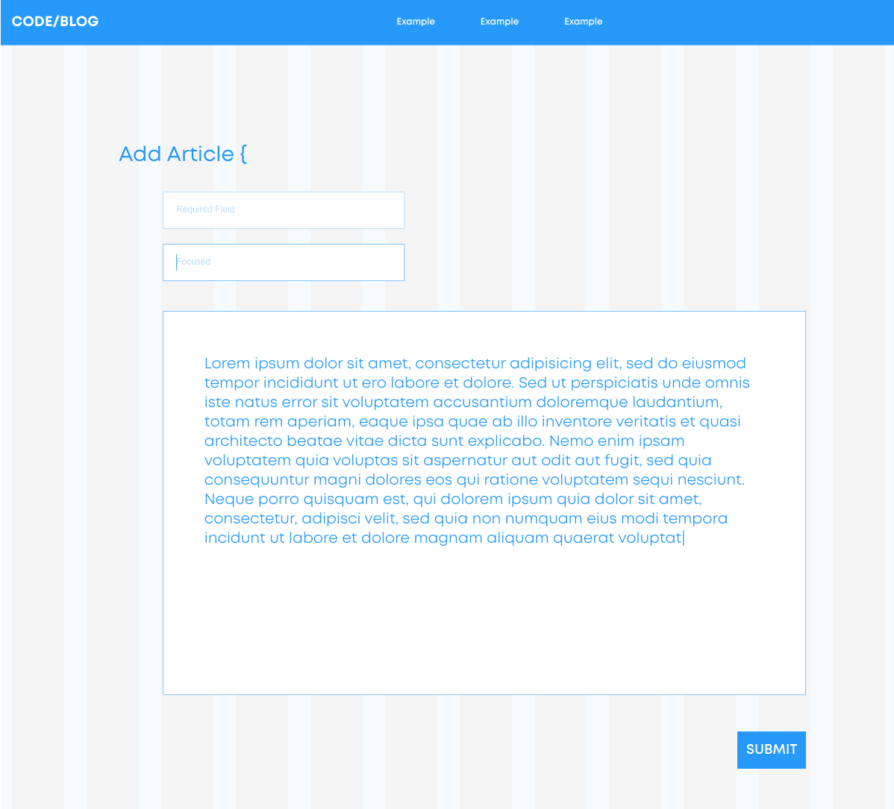
design process
Agile - “sprint tests”
The input form…
Simple, clean - code is confusing enough!

Slide 5






tech used
Passport

Slide 6
demo
kodeBlogger

Slide 7
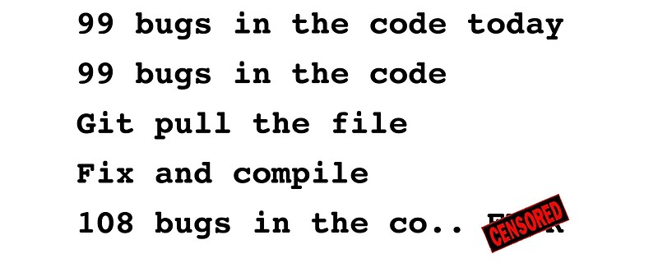


The Future
Bug fixes
Ability to change display mode
More in-depth search - categorize and sort posts

